Slide 1
Implementation of Transformer-Based Visual Segmentation
Nandan Menon, Mukhil Charles T, Jeevithesh R

Slide 2
Abstract
Overview of CNN and Transformer models in segmentation. Focus on semantic, instance, and panoptic segmentation. Qualitative comparisons using the COCO dataset.

Slide 3
Introduction
Image segmentation is key in vision tasks. CNNs are strong in spatial hierarchies but weak in long-range dependencies. Transformers, with self-attention, handle global context better.

Slide 4
Objectives
• Implement CNN and Transformer models
• Compare segmentation tasks qualitatively
• Understand architectural and practical differences

Slide 5
Models Used
Semantic Segmentation:
- DeepLabV3 (CNN)
- SegFormer (Transformer)
Instance Segmentation:
- Mask R-CNN (CNN)
- Mask2Former (Transformer)
Panoptic Segmentation:
- Panoptic FPN (CNN)
- Mask2Former (Transformer)

Slide 6
Dataset
COCO validation set used
- 80+ annotated classes
- Focused on subset due to compute limits

Slide 7
Evaluation Metrics
• mIoU: Semantic segmentation

Slide 8
Implementation Details
Environment: Google Colab with Tesla T4 GPU
Libraries: Hugging Face, Detectron2
Steps: Preprocessing → Inference → Visualization

Slide 9
Challenges
• Limited GPU memory
• Runtime errors in heavy Transformer models
• Quantitative eval limited to sample outputs

Slide 10
Conclusion
• Both model types effective
• Transformers excel in fine-grain, complex scenes
• Valuable practical insights gained

Slide 11
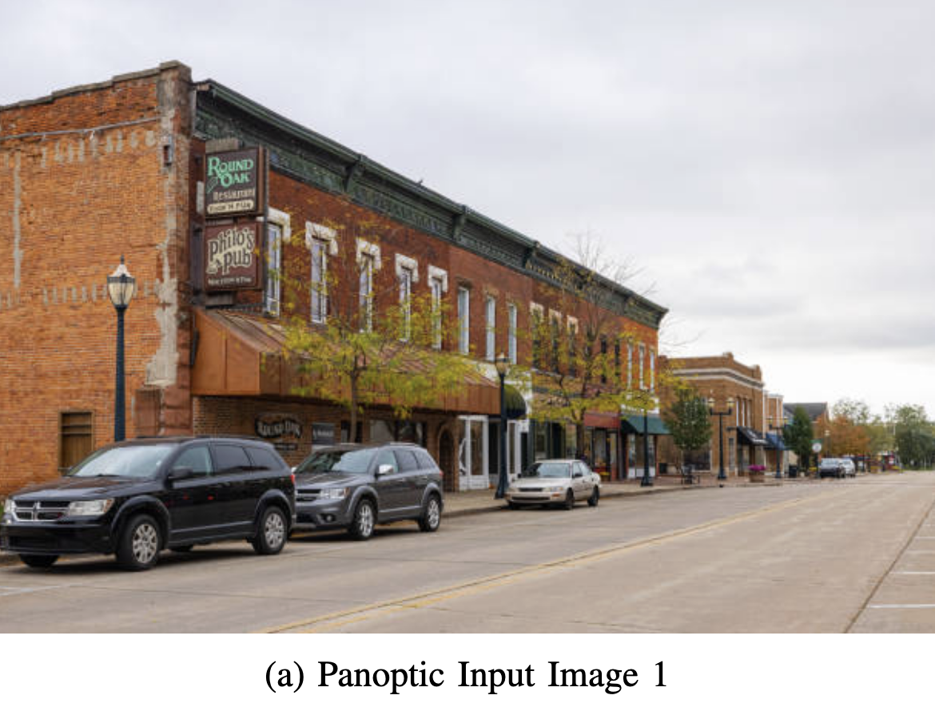
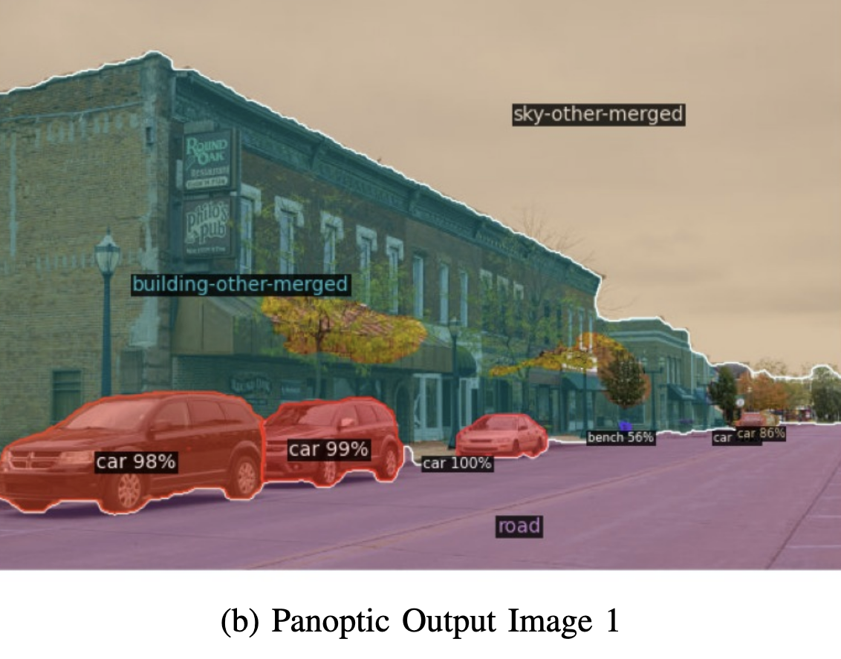
Panoptic Segmentation: Image 1

Slide 12
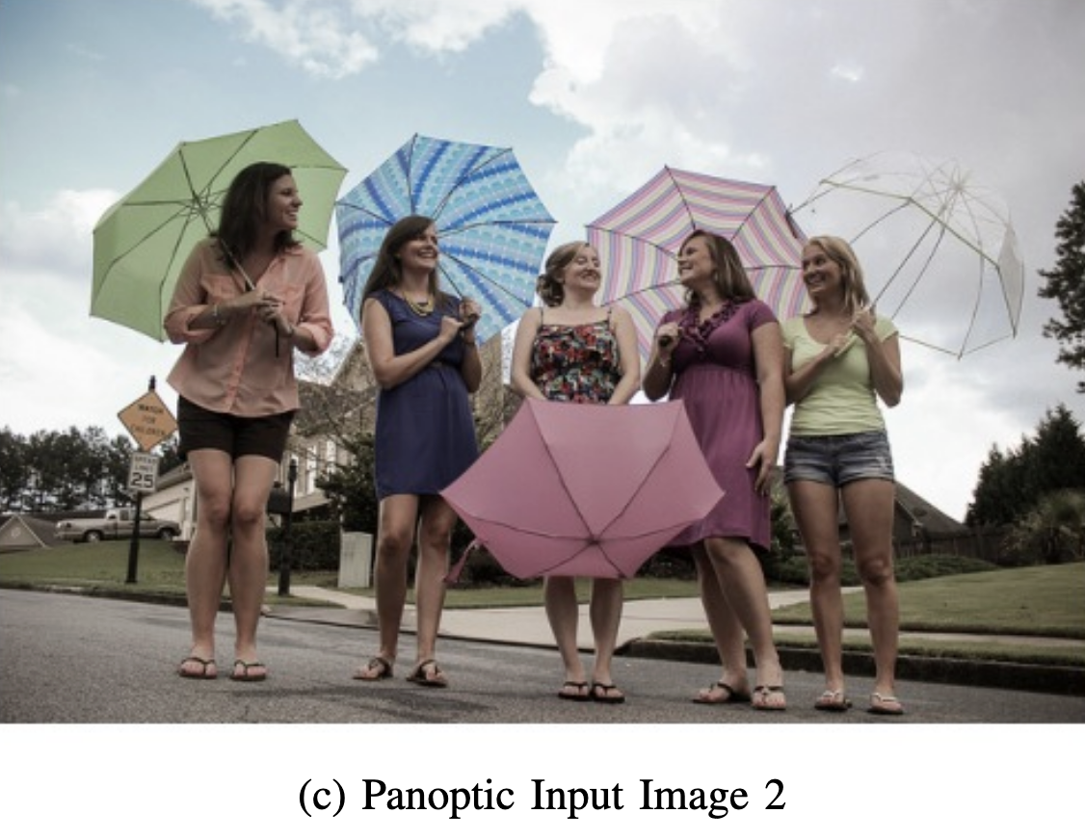
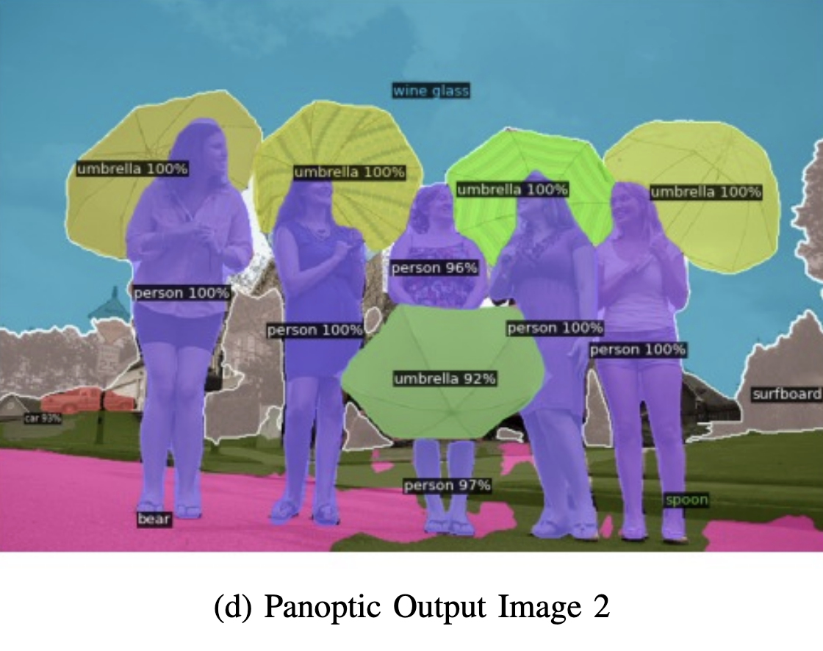
Panoptic Segmentation: Image 2

Slide 13
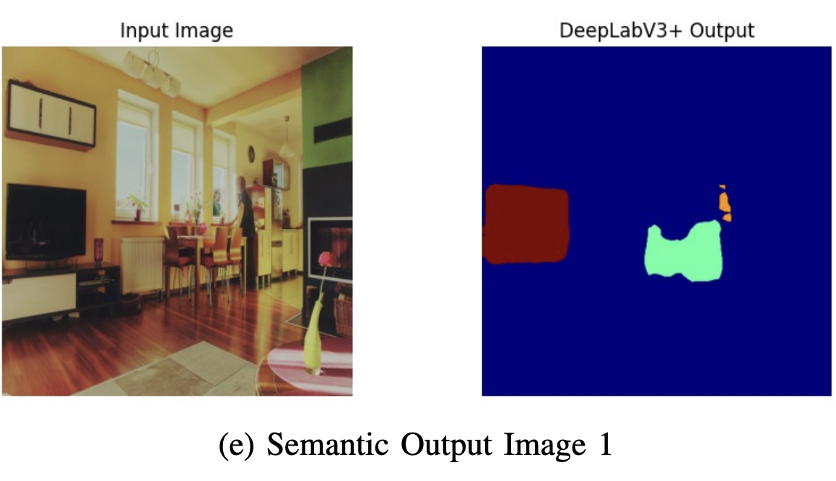
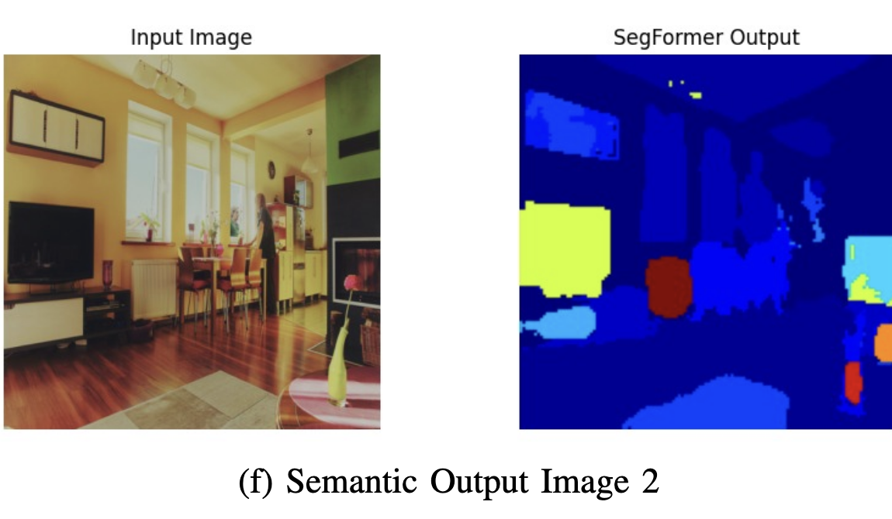
Semantic Segmentation: DeepLabV3+

